Slide 1
Colour & Stencil Recognition

Slide 2
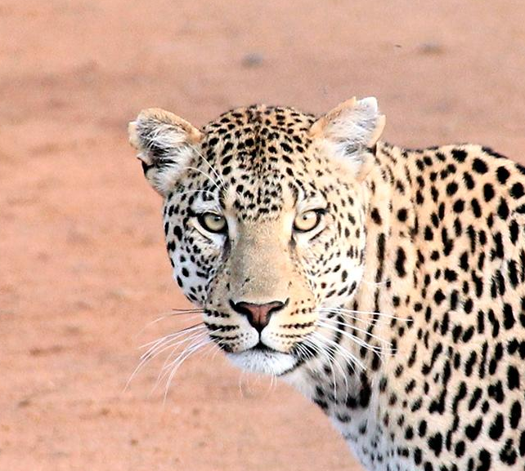
Aim
To Implement a Visual Recognition Model which can detect Color Name & Stencil Designs.

Slide 3
Steps to Implementation
Create a Project
Add Visual Recognition and Watson Service into it.
Collect Dataset of Images of Different Colors and Stencils for Training.
Upload the Data to the Model.
Define Different Classes and classify each image according to it.
Train the model.
Test it with Different Images to check the accuracy of the model.

Slide 4
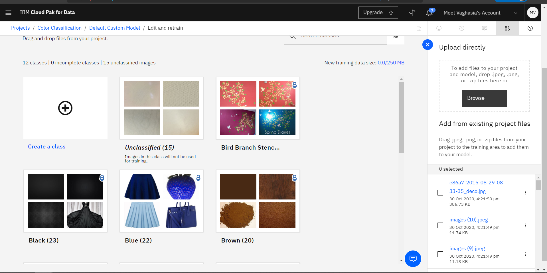
Defining Classes and Training the Model
Place your screenshot here
Screenshots

Slide 5
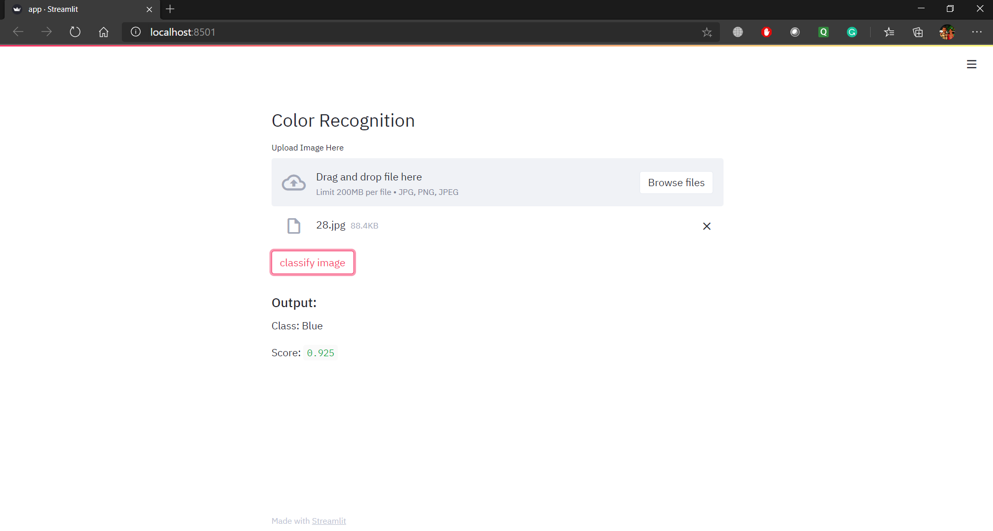
Defining Classes and Training the Model
Place your screenshot here
Screenshots

Slide 6
Thanks!

